Slide 1

ATTC’s LRUC ROOM BOOKING SYSTEM
Presented by
Ali Ahmed A23DCE02
Deep Karmakar A23DCE10
Durga Nand Chaudhary A24DCE-L03
Under the guidance of Mr. Nirnaya Pradhan
Lecturer, Selection Grade I
Department of Computer Engineering

Slide 2
Abstract
The Room Booking System is a PHP-based Web app that lets user book ATTC’s LRUC Rooms online to manage bookings efficiently.

Slide 3
Introduction
ATTC’s LRUC Room Booking System is a Web Application that allows users to book rooms online.
It helps both customers and staff manage room availability and reservations efficiently.
Doesn’t allow user to go for a which is already booked slot.
This project is built using PHP and MySQL.

Slide 4
Problem statement
Manual ATTC’s LRUC room booking leads to errors and confusion. Users can’t easily check ATTC’s LRUC room availability. Double bookings and delays often occur. A digital system is needed for easy booking and management.

Slide 5
Scope of the project
Allows users to view available rooms and book them online.
Provides real-time room availability and booking confirmation.
Includes secure user login and session management.
Can generate booking reports for analysis.
Improves booking efficiency and reduces manual errors.
It never get a user to access for a Double Booking.

Slide 6
Objective
To develop an automated system for ATTC’s LRUC Room Booking System. Reduce manual errors and improve customer service.

Slide 7
Methodology
1. Collect Requirements:- Understand user needs.
2. Design System:- Plan interface and database.
3. Develop System:- Build frontend and backend.
4. Set Up Databases:- Store room and booking info.
5. Test Features:- Check Login, Booking, No Double Booking.

Slide 8
Software Requirements
1. Operating System: Windows / Linux / MacOS
2. Frontend: HTML, CSS, JavaScript
3. Backend: PHP
4. Database: MySQL
5. Web Server: Apache
6. Browser: Google Chrome / Firefox

Slide 9
Hardware Requirements
1. Processor: Intel i3 , i5, i7
2. RAM: 8 GB/ 16GB
3. Storage: 256GB / 512GB
4. Internet: Stable connection for online access

Slide 10
Functional Requirements
1. User Login:- Users can log in securely.
2. Room Browsing:- Users can view available rooms with details.
3. Room Booking:- Users can book rooms by selecting date, time and which period.

Slide 11
Non-functional Requirements
1. Fast:- Pages should load quickly.
2. Secure:- User data must be protected.
3. Easy to Use:- Simple and user-friendly interface.
4. Scalable:- Can handle more users in the future.

Slide 12
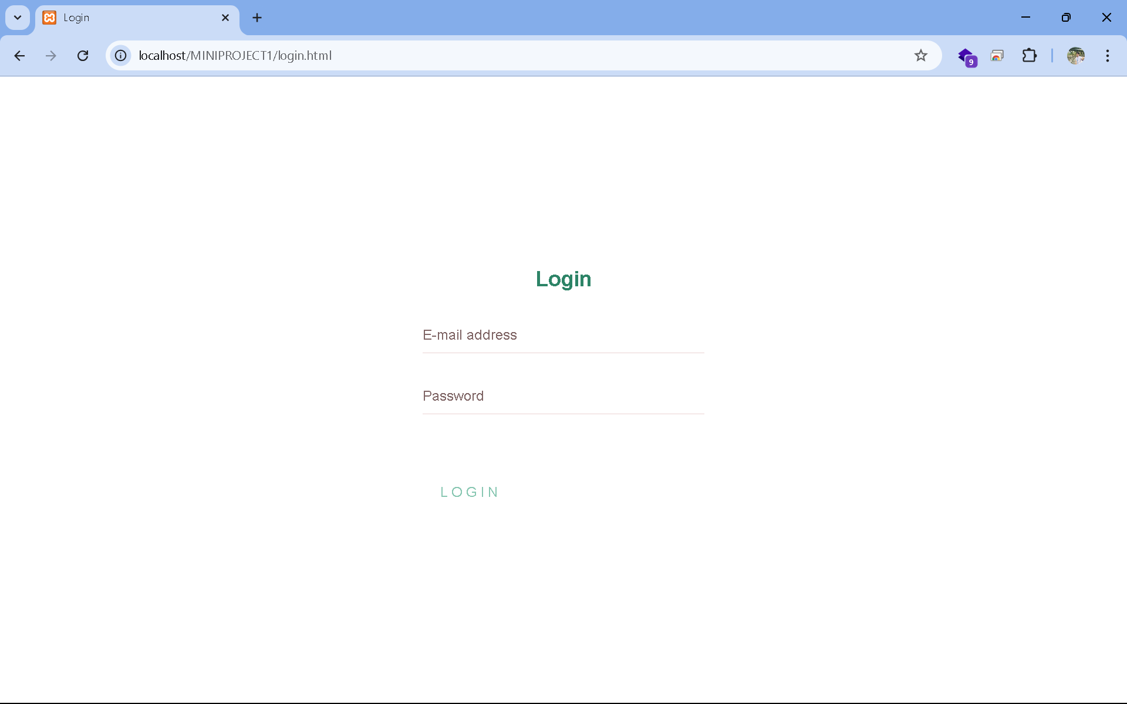
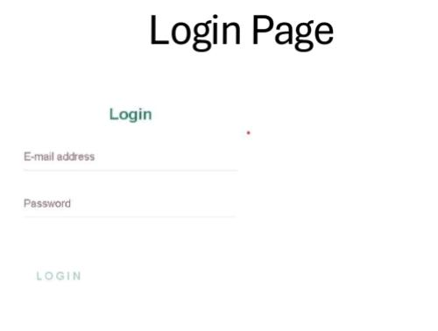
Screenshot of project Demo
Login Page

Slide 13
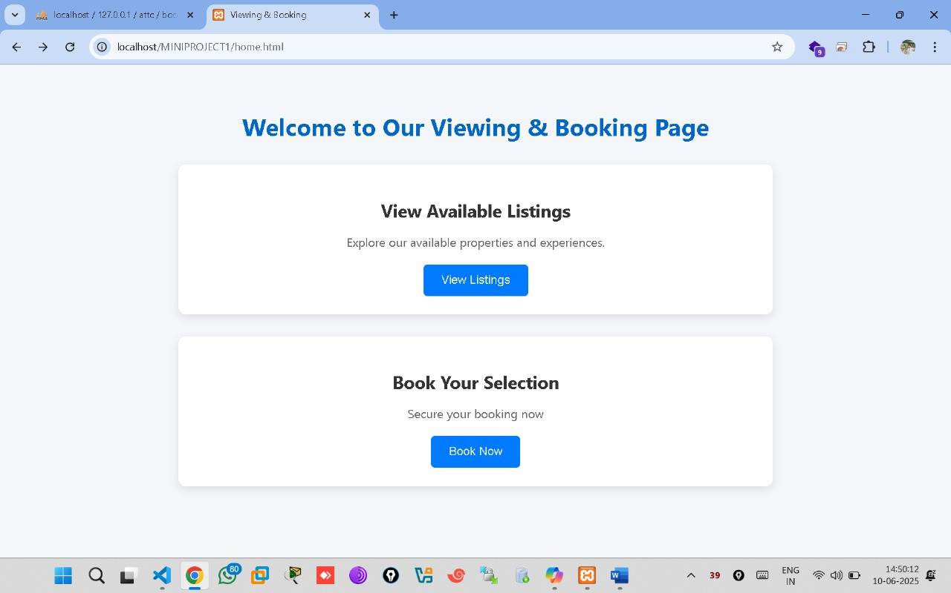
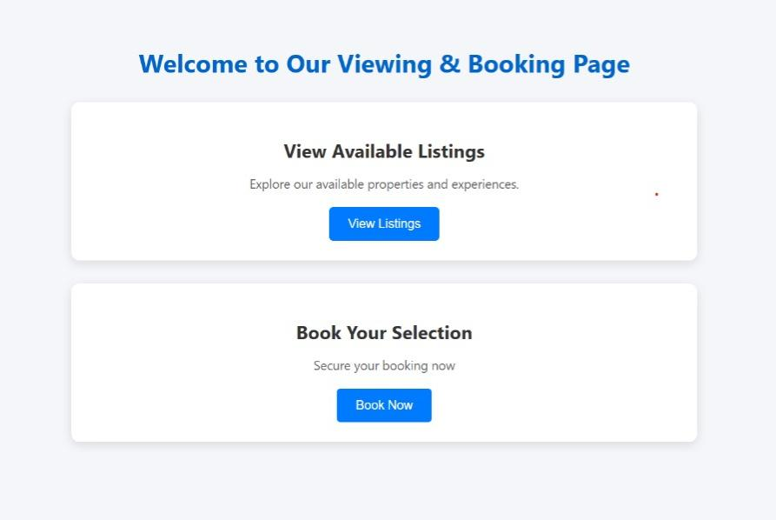
Screenshot of project Demo
Home Page

Slide 14
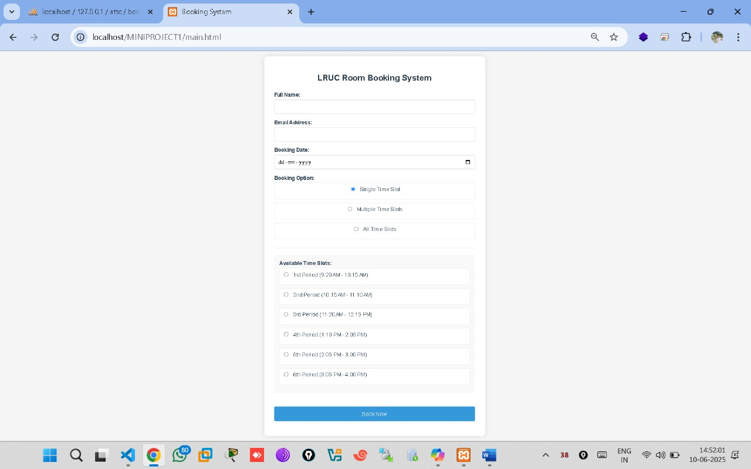
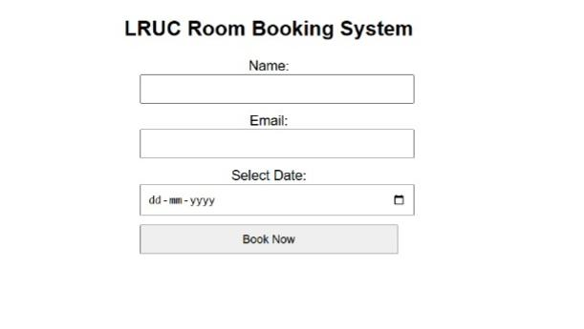
Screenshot of project Demo
Reservation Page

Slide 15
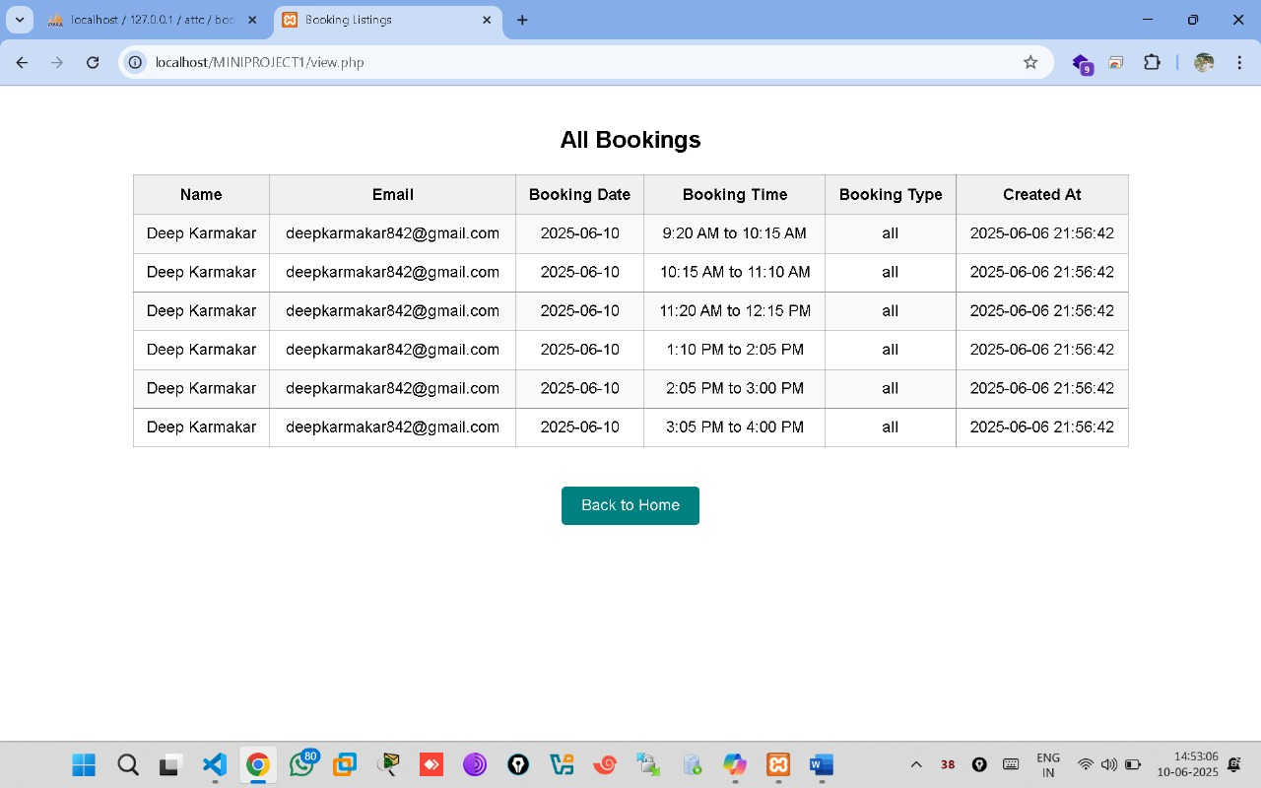
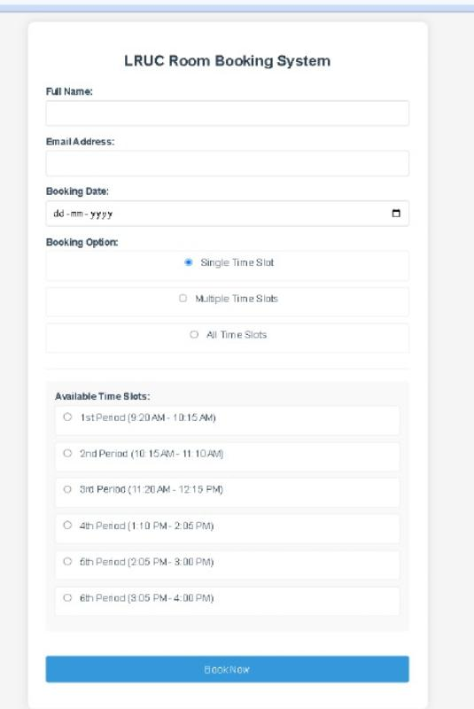
Screenshot of project Demo
Status Page

Slide 16
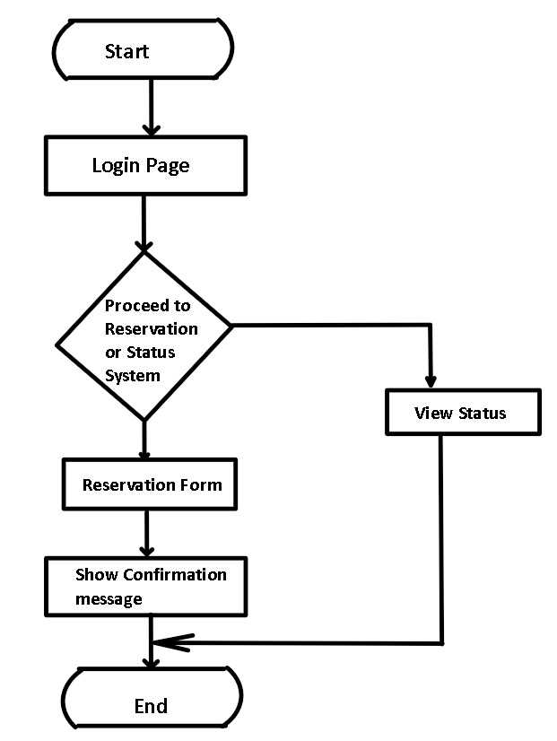
Flowchart

Slide 17
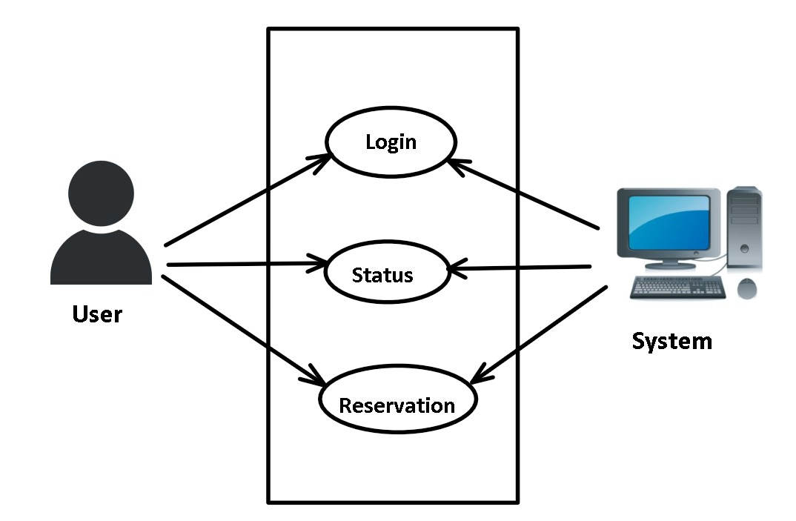
Use Case Diagram

Slide 18
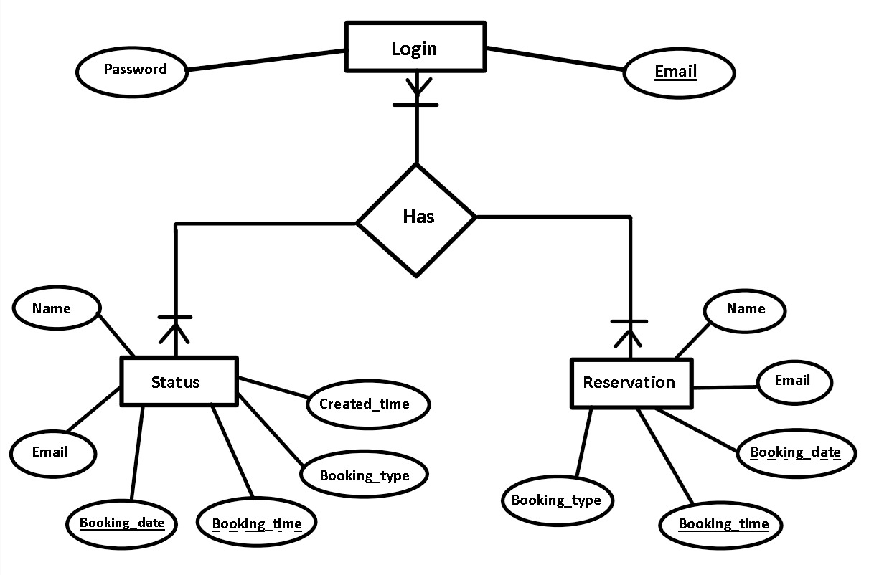
ER Diagram

Slide 19
Testing Case
1. Login:- User can log in with correct details.
2. Check Rooms:-Show available rooms by date and time.
3. Book Room:- Booking works with valid info.
4. Double Booking:-Same room can't be booked twice.

Slide 20
References
ChatGPT:- https://chatgpt.com/
DeepSeek:- https://chat.deepseek.com/

Slide 21
Future Work
1. Real-Time Availability Updates:- Instant sync of room status. 2. Customer Feedback System:- Allow users to rate and review rooms. 3. Email/SMS Notifications:- Send booking confirmations and reminders.

Slide 22
Acknowledgement
We would like to express our sincere gratitude to all those who supported us throughout the development of this project. We are especially thankful to our project guide Mr. Nirnaya Pradhan for their constant guidance and encouragement. We also thank the faculty and staff of Advanced Technical Training Centre, whose valuable feedback and support played a crucial role. Finally, we are grateful to our family and friends for their constant motivation and support.

Slide 23
Conclusion
The ATTC’s LRUC Room Booking System enhances the efficiency of room operations. It reduces manual work and makes the booking process user-friendly.

Slide 24
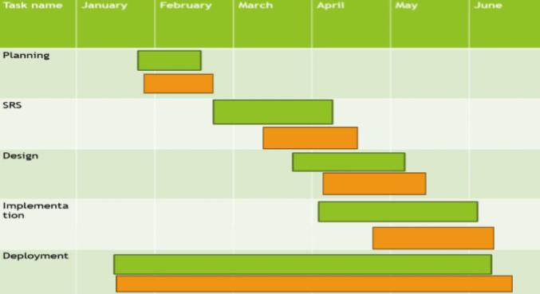

Gantt chart

Slide 25
Thank You

